Slide 1
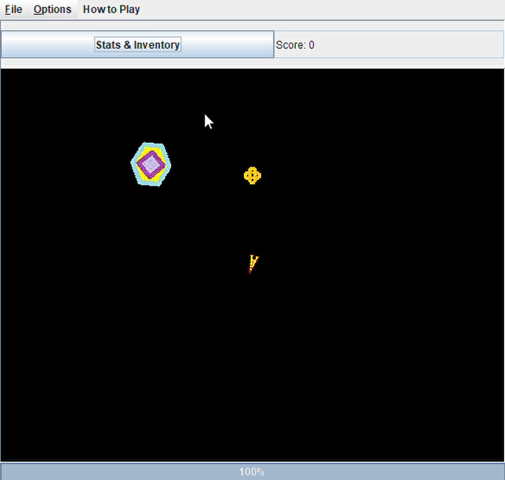
Space Pirates
Charles Kinser, William Kinser, Sam Reynolds

Slide 2
The Team
Charles Kinser – Game concept and “product owner”, game physics for motion, collision detection/reaction, orbit detection/capture, and POV (point of view) window direction.
William Kinser – High level design classes and initial structures, file I/O, and non-graphical game logic
Sam Reynolds – Treasure creation/tracking, game statistics, images.

Slide 3





Purpose
Using the classic Asteroids game from the 1980s as inspiration,
Space Pirates is a game where the user pilots a small ship through a galactic arena of
asteroids,
space stations,
booty, etc.
The goal is to collect as much booty as possible without dying

Slide 4
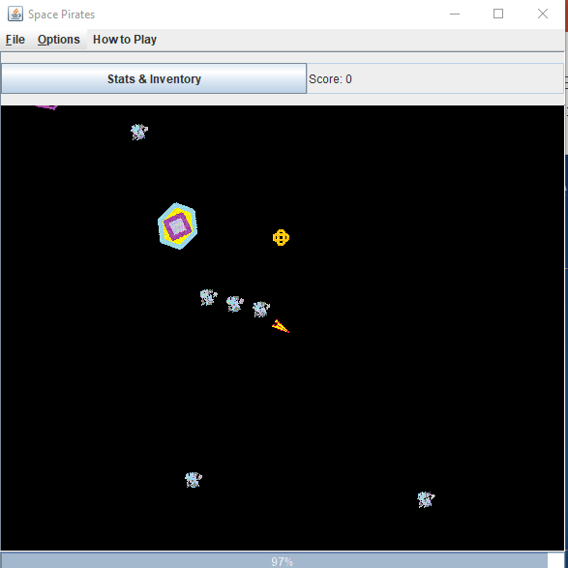
Demo Time

Slide 5
Interesting Game Features
“Game Space” is infinite (no wrap around of screen edges)
POV is fixed on main ship
myRowOffset = mainShip.getX ( ) - ((int) width / 2 - mainShip.getImage ( ).getWidth ( ) / 2);
myColOffset = mainShip.getY ( ) - ((int) height / 2 - mainShip.getImage ( ).getHeight ( ) / 2);
g2.translate (-myRowOffset, -myColOffset);

Slide 6
Interesting Game Features
Realistic physics behind motion and collisions
// loop to create size # of small asteroids
for (int i=0; i < size; i++)
{
// create small asteroid with the same x,y as this and proportional mass
SmallAsteroid debrisItem = new SmallAsteroid(getX ( ), getY(),
getMass()/size,getSpeed());
// set speed angle to be a random trajectory
debrisItem.setSpeedAng (Math.random()*2*Math.PI);
// set speed to be up to twice this one
debrisItem.setSpeed (Math.random()*2*getSpeed());
debrisField.add (debrisItem);
// separate the vector into individual components
double deltaX = speed*Math.cos(speedAng);
double deltaY = speed*Math.sin(speedAng);
…
// use physics formulas to calculate new vectors
// formulas differ based on whether or not objects are at rest
if ((deltaX == 0 && deltaY == 0)) {
newDX = (mass2 * deltaX2) / mass;
newDY = (mass2 * deltaY2) / mass;
}
…
// apply new values to the objects
refAngle = Math.atan(Math.abs (newDY/newDX));
refAngle2 = Math.atan(Math.abs (newDY2/newDX2));

Slide 7
Images for space objects are loaded in real time into static array based on class names
Interesting Game Features
private BufferedImage fetchImage()
{
String name = this.getClass ( ).getName ( );
// if class name prefixed with package name, remove the package name
if (name.contains (".")) {
name = name.substring (name.lastIndexOf (".")+1);
}
// see if we've already loaded this image. Since static, no need to load it more than once
BufferedImage i = ourImages.get (name);
if (i == null) {
// load the image and add it to the hashmap
try {
i = ImageIO.read(new File(name+".gif"));
ourImages.put(name,i);
}
catch (Exception e) {}
}
return i;
}

Slide 8
Save & Load of Game State
Interesting Game Features
…..SAVE
try {
out.writeInt(health);
out.writeBoolean (gameInProgress);
out.writeInt (difficulty);
} catch (IOException e) {
errors = new String("Errors while saving frame data.");
}
…..LOAD
try {
health = in.readInt();
gameInProgress = in.readBoolean ();
difficulty = in.readInt ();
} catch (IOException e) {
errors = new String ("Error while loading frame data.");
}

Slide 9
Custom Events & Listeners AKA Callbacks
Interesting Game Features
Interface Class
public interface OrbitListener {
public void orbitChanged(boolean orbiting); }
public void addOrbitListener(OrbitListener listener) {
this.orbitListener = listener;
public void addMainShip (SpaceShip ship) {
…
mainShip.addOrbitListener(PirateFrame.ourFrame);
SpaceShip holds interface as member data
SpacePanel creates SpaceShip, registers PirateFrame as listener

Slide 10
Custom Events & Listeners AKA Callbacks
Interesting Game Features
When event is detected in SpaceShip, call listener
private void notifyOrbitListener(boolean orbiting) {
if (this.orbitListener != null)
this.orbitListener.orbitChanged (orbiting);
public void orbitChanged (boolean orbiting) {
…
if (orbiting) {
setGamePaused(true);
…
Object answer = JOptionPane.showInputDialog (this, "You've docked with a station! \n" +
…
PirateFrame catches event and performs actions

Slide 11
Zoom in and Out
Interesting Game Features
public void mouseWheelMoved (MouseWheelEvent e) {
if (e.getWheelRotation ( ) < 0) // Zoom In
zoomFactor *= 1.1;
if (e.getWheelRotation ( ) > 0) { // Zoom Out
zoomFactor /= 1.1;
public void paintComponent (Graphics g) {
Graphics2D g2 = (Graphics2D) g;
AffineTransform at = new AffineTransform();
at.scale(zoomFactor, zoomFactor);
g2.transform(at);
…

Slide 12
Rotating each image independently
Interesting Game Features
Inside SpacePanel’s paintComponent method
for (SpaceObject obj : this.objects) {
BufferedImage image = obj.getImage ( );
Graphics2D g22 = (Graphics2D)g.create ( );
g22.rotate(obj.getRotation ( ),
(int)(obj.getX())+image.getWidth ( )/2,
(int)(obj.getY())+image.getHeight ( )/2);
g22.drawImage (image, (int)(obj.getX()), (int)(obj.getY()), null);
obj.setRotation (obj.getRotation ( )+obj.getRotationRate());
g22.dispose ( );

Slide 13
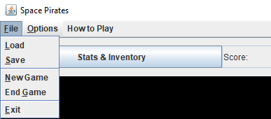
Meeting Requirements
PirateFrame contains a menu bar (with file i/o options, game settings, and help )
PirateFrame contains a JSplitPanel on a border layout. The top part is a panel for buttons (PirateBtnPanel) which contains a button for game statistics and a text box displaying the score. The bottom part is the graphic game screen (SpacePanel)
The frame is resizable so players can see more of the game space (they can also zoom in and out using the mouse wheel)
All control borders are the default.
Multiple mouse listeners are used to control the main space ship
Custom listeners (interface classes) are defined for game specific events such as treasure being captured and docking.
The “How to Play” popup is derived from JDialog.
The game play graphics are attractive and professional looking
The Load and Save use JFileChooser to select files on the system.
Exception handling exists in several areas (mostly around I/O and system interactions)

Slide 14
Meeting Requirements
The game was developed on several different computers with screens of different sizes and quality. The default game window size is half of a normal screen size and can be resized by the user.
Both arrays and ArrayLists are used throughout. Primarily primitive collections are made with arrays and object collections are made with ArrayLists (this is a general statement and not an absolute design rule).
OOD/OOP principles and patterns were generally followed but additional refactoring could be done to further decouple the UI classes from the core game classes by moving non-UI elements and methods into SpacePirateGame
Having said that, one example of inheritance and polymorphism can be seen in that all objects that can exist in space are derived from a common class, SpaceObject. All weapons that are used (Missile, Laser, Torpedo, ClusterBomb) all derive from Weapon which is a subclass of SpaceObject. SpaceStation is a specialization of WeighStation which is also a subclass of SpaceObject.
This hierarchy allows all the common physics calculations to occur in the base classes leaving most of the specialized classes overriding only a few methods to customize certain behaviors.

Slide 15
Conclusion
Most of our planned game features were implemented
It is very playable
The design is extensible (more weapons could be added or more objects can be added with minimal code changes)
GitHub was leveraged to share and merge code (along with a Punch List). This made it fairly easy for Sam to join midstream.
We had fun developing it (because it was challenging yet achievable)
The Game Works!

Slide 16
Demo Time

